Slide 1
Mining Association Rules in Large Databases
Notes:
1

Slide 2
Association rule mining
Proposed by Agrawal et al in 1993.
It is an important data mining model studied extensively by the database and data mining community.
Assume all data are categorical.
No good algorithm for numeric data.
Initially used for Market Basket Analysis to find how items purchased by customers are related.
Bread → Milk [sup = 5%, conf = 100%]

Slide 3
The model: data
I = {i₁, i₂, …, i_{m}}: a set of items.
Transaction t :
t a set of items, and t ⊆ I.
Transaction Database T: a set of transactions T = {t₁, t₂, …, t_{n}}.

Slide 4
Transaction data: supermarket data
Market basket transactions:
t1: {bread, cheese, milk}
t2: {apple, eggs, salt, yogurt}
… …
tn: {biscuit, eggs, milk}
Concepts:
An item: an item/article in a basket
I: the set of all items sold in the store
A transaction: items purchased in a basket; it may have TID (transaction ID)
A transactional dataset: A set of transactions

Slide 5
Transaction data: a set of documents
A text document data set. Each document is treated as a “bag” of keywords
doc1: Student, Teach, School
doc2: Student, School
doc3: Teach, School, City, Game
doc4: Baseball, Basketball
doc5: Basketball, Player, Spectator
doc6: Baseball, Coach, Game, Team
doc7: Basketball, Team, City, Game

Slide 6
The model: rules
A transaction t contains X, a set of items (itemset) in I, if X ⊆ t.
An association rule is an implication of the form:
X → Y, where X, Y ⊂ I, and X ∩Y = ∅
An itemset is a set of items.
E.g., X = {milk, bread, cereal} is an itemset.
A k-itemset is an itemset with k items.
E.g., {milk, bread, cereal} is a 3-itemset

Slide 7
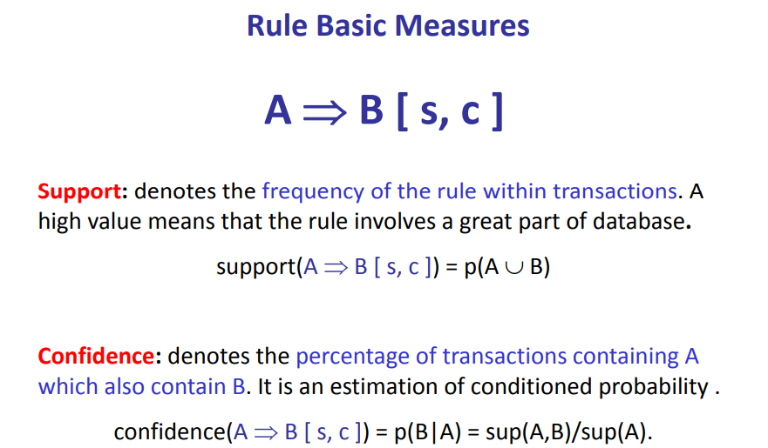

Slide 8
Basic Concepts: Association Rules
Tid
Items bought
Find all the rules X → Y with minimum support and confidence
support, s, probability that a transaction contains X ∪ Y
confidence, c, conditional probability that a transaction having X also contains Y
Let minsup = 50%, minconf = 50%
Freq. Pat.: Beer:3, Nuts:3, Diaper:4, Eggs:3, {Beer, Diaper}:3
10
Beer, Nuts, Diaper
20
Beer, Coffee, Diaper
30
Beer, Diaper, Eggs
40
Nuts, Eggs, Milk
50
Nuts, Coffee, Diaper, Eggs, Milk
Customer
buys both
Customer
buys diaper
Customer
buys beer
Association rules: (many more!)
Beer → Diaper (60%, 100%)
Diaper → Beer (60%, 75%)

Slide 9
An example
t1: Beef, Chicken, Milk
t2: Beef, Cheese
t3: Cheese, Boots
t4: Beef, Chicken, Cheese
t5: Beef, Chicken, Clothes, Cheese, Milk
t6: Chicken, Clothes, Milk
t7: Chicken, Milk, Clothes
Transaction data
Assume:
minsup = 30%
minconf = 80%
An example frequent itemset:
{Chicken, Clothes, Milk} [sup = 3/7]
Association rules from the itemset:
Clothes → Milk, Chicken [sup = 3/7, conf = 3/3]
… …
Clothes, Chicken → Milk, [sup = 3/7, conf = 3/3]

Slide 10
Goal & key features
Goal: In general, association rule mining can be viewed as a two-step process:
Find all frequent itemsets: By definition, each of these itemsets will occur at least as frequently as a predetermined minimum support count, min sup.
2. Generate strong association rules from the frequent itemsets: By definition, these rules must satisfy minimum support and minimum confidence
Key Features
Completeness: find all rules.
Mining with data on hard disk (not in memory)

Slide 11
Transaction data representation
A simplistic view of shopping baskets,
Some important information not considered. E.g,
the quantity of each item purchased and
the price paid.

Slide 12
Many mining algorithms
There are a large number of them!!
They use different strategies and data structures.
Their resulting sets of rules are all the same.
Given a transaction data set T, and a minimum support and a minimum confident, the set of association rules existing in T is uniquely determined.
Any algorithm should find the same set of rules although their computational efficiencies and memory requirements may be different.

Slide 13
Finding frequent sets
Task: Given a transaction database D and a minsup threshold find all frequent itemsets and the frequency of each set in this collection
Stated differently: Count the number of times combinations of attributes occur in the data. If the count of a combination is above minsup report it.
Recall: The input is a transaction database D where every transaction consists of a subset of items from some universe I
Notes:
13

Slide 14
How many itemsets are there?
Given d items, there are 2^{d} possible itemsets
Notes:
14

Slide 15
When is the task sensible and feasible?
If minsup = 0, then all subsets of I will be frequent and thus the size of the collection will be very large
This summary is very large (maybe larger than the original input) and thus not interesting
The task of finding all frequent sets is interesting typically only for relatively large values of minsup
Notes:
15

Slide 16
A simple algorithm for finding all frequent itemsets ??
Notes:
16

Slide 17
Brute-force algorithm for finding all frequent itemsets?
Generate all possible itemsets (lattice of itemsets)‏
Start with 1-itemsets, 2-itemsets,...,d-itemsets
Compute the frequency of each itemset from the data
Count in how many transactions each itemset occurs
If the support of an itemset is above minsup report it as a frequent itemset

Slide 18
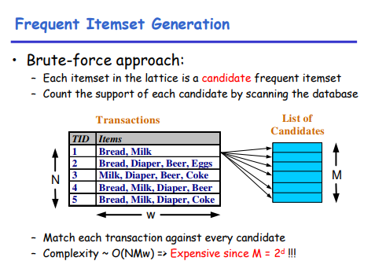

Slide 19
Speeding-up the brute-force algorithm
Reduce the number of candidates (M)‏
Complete search: M=2^{d}
Use pruning techniques to reduce M
Reduce the number of transactions (N)‏
Reduce size of N as the size of itemset increases
Use vertical-partitioning of the data to apply the mining algorithms
Reduce the number of comparisons (NM)‏
Use efficient data structures to store the candidates or transactions
No need to match every candidate against every transaction
Notes:
19

Slide 20
Reduce the number of candidates
Apriori principle (Main observation):
If an itemset is frequent, then all of its subsets must also be frequent
Apriori principle holds due to the following property of the support measure:
The support of an itemset never exceeds the support of its subsets
This is known as the anti-monotone property of support
Notes:
20

Slide 21
Example
s(Bread) > s(Bread, Beer)‏
s(Milk) > s(Bread, Milk)‏
s(Diaper, Beer) > s(Diaper, Beer, Coke)‏
Notes:
21

Slide 22
Illustrating the Apriori principle
Found to be Infrequent
Pruned supersets
Notes:
22

Slide 23
The Apriori Algorithm — Example
Database D
L₁
C₁
Scan D
C₂
C₂
L₂
Scan D
C₃
Scan D
L₃

Slide 24
Illustrating the Apriori principle
Items (1-itemsets)‏
Pairs (2-itemsets)‏
(No need to generate candidates involving Coke or Eggs)‏
minsup = 3/5
Triplets (3-itemsets)‏
If every subset is considered,
⁶C₁ + ⁶C₂ + ⁶C₃ = 41
With support-based pruning,
6 + 6 + 1 = 13
Notes:
24

Slide 25
Exploiting the Apriori principle
Find frequent 1-items and put them to L_{k} (k=1)‏
Use L_{k} to generate a collection of candidate itemsets C_{k+1} with size (k+1)‏
Scan the database to find which itemsets in C_{k+1} are frequent and put them into L_{k+1}
If L_{k+1} is not empty
k=k+1
Goto step 2
R. Agrawal, R. Srikant: "Fast Algorithms for Mining Association Rules",
Proc. of the 20th Int'l Conference on Very Large Databases, 1994.
Notes:
25

Slide 26
The Apriori algorithm
C_{k}: Candidate itemsets of size k
L_{k} : frequent itemsets of size k
L₁ = {frequent 1-itemsets};
for (k = 2; L_{k} !=∅; k++)
C_{k+1} = GenerateCandidates(L_{k})‏
for each transaction t in database do
increment count of candidates in C_{k+1} that are contained in t
endfor
L_{k+1} = candidates in C_{k+1} with support ≥min_sup
endfor
return ∪_{k} L_{k};

Slide 27
GenerateCandidates
Assume the items in L_{k} are listed in an order (e.g., alphabetical)‏
Step 1: self-joining L_{k} (IN SQL)‏
insert into C_{k+1}
select p.item₁, p.item₂, …, p.item_{k}, q.item_{k}
from L_{k} p, L_{k} q
where p.item₁=q.item₁, …, p.item_{k-1}=q.item_{k-1}, p.item_{k} < q.item_{k}
Notes:
27

Slide 28
Example of Candidates Generation
L₃={abc, abd, acd, ace, bcd}
Self-joining: L₃*L₃
abcd from abc and abd
acde from acd and ace
{a,c,d}
{a,c,e}
{a,c,d,e}
acd
ace
ade
cde
Notes:
28

Slide 29
GenerateCandidates
Assume the items in L_{k} are listed in an order (e.g., alphabetical)‏
Step 1: self-joining L_{k} (IN SQL)‏
insert into C_{k+1}
select p.item₁, p.item₂, …, p.item_{k}, q.item_{k}
from L_{k} p, L_{k} q
where p.item₁=q.item₁, …, p.item_{k-1}=q.item_{k-1}, p.item_{k} < q.item_{k}
Step 2: pruning
forall itemsets c in C_{k+1} do
forall k-subsets s of c do
if (s is not in L_{k}) then delete c from C_{k+1}
Notes:
29

Slide 30
Example of Candidates Generation
L₃={abc, abd, acd, ace, bcd}
Self-joining: L₃*L₃
abcd from abc and abd
acde from acd and ace
Pruning:
acde is removed because ade is not in L₃
C₄={abcd}
{a,c,d}
{a,c,e}
X
{a,c,d,e}
acd
ace
ade
cde
√
√
X
Notes:
30

Slide 31
The Apriori algorithm
C_{k}: Candidate itemsets of size k
L_{k} : frequent itemsets of size k
L₁ = {frequent items};
for (k = 1; L_{k} !=∅; k++)
C_{k+1} = GenerateCandidates(L_{k})‏
for each transaction t in database do
increment count of candidates in C_{k+1} that are contained in t
endfor
L_{k+1} = candidates in C_{k+1} with support ≥min_sup
endfor
return ∪_{k} L_{k};

Slide 32
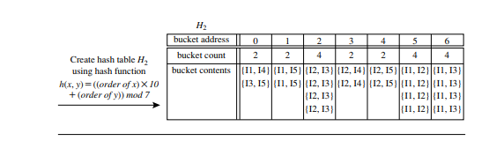
Hash table

Slide 33
How to Count Supports of Candidates?
Naive algorithm?
Method:
Candidate itemsets are stored in a hash-tree
Leaf node of hash-tree contains a list of itemsets and counts
Interior node contains a hash table
Subset function: finds all the candidates contained in a transaction
Notes:
33

Slide 34
Example of the hash-tree for C₃
Hash function: mod 3
H
H
Hash on 1st item
1,4,..
2,5,..
3,6,..
H
234
567
H
Hash on 2nd item
145
H
345
356
689
367
368
Hash on 3rd item
124
457
125
458
159
Notes:
34

Slide 35
Example of the hash-tree for C₃
2345
look for 2XX
345
look for 3XX
Hash function: mod 3
12345
H
H
Hash on 1st item
12345
look for 1XX
1,4,..
2,5,..
3,6,..
H
234
567
H
Hash on 2nd item
145
H
345
356
689
367
368
Hash on 3rd item
124
457
125
458
159
Notes:
35

Slide 36
Example of the hash-tree for C₃
2345
look for 2XX
345
look for 3XX
Hash function: mod 3
12345
H
H
Hash on 1st item
12345
look for 1XX
1,4,..
2,5,..
3,6,..
H
234
567
H
Hash on 2nd item
12345
look for 12X
∅
145
H
345
356
689
367
368
12345
look for 13X (null)‏
124
457
125
458
159
12345
look for 14X
The subset function finds all the candidates contained in a transaction:
At the root level it hashes on all items in the transaction
At level i it hashes on all items in the transaction that come after item the i-th item
Notes:
36

Slide 37
Discussion of the Apriori algorithm
Much faster than the Brute-force algorithm
It avoids checking all elements in the lattice
The running time is in the worst case O(2^{d})‏
Pruning really prunes in practice
It makes multiple passes over the dataset
One pass for every level k
Multiple passes over the dataset is inefficient when we have thousands of candidates and millions of transactions

Slide 38
Making a single pass over the data: the AprioriTid algorithm
The database is not used for counting support after the 1st pass!
Instead information in data structure C_{k}’ is used for counting support in every step
C_{k}’ = {<TID, {X_{k}}> | X_{k} is a potentially frequent k-itemset in transaction with id=TID}
C₁’: corresponds to the original database (every item i is replaced by itemset {i})‏
The member C_{k}’ corresponding to transaction t is <t.TID, {c є C_{k}| c is contained in t}>
Notes:
38

Slide 39
The AprioriTID algorithm
L₁ = {frequent 1-itemsets}
C₁’ = database D
for (k=2, L_{k-1}’≠ empty; k++)‏
C_{k} = GenerateCandidates(L_{k-1})‏
C_{k}’ = {}
for all entries t є C_{k-1}’
C_{t}= {cє C_{k}|t[c-c[k]]=1 and t[c-c[k-1]]=1}
for all cє C_{t} {c.count++}
if (C_{t}≠ {})
append C_{t} to C_{k}’
endif
endfor
L_{k}= {cє C_{k}|c.count >= minsup}
endfor
return U_{k} L_{k}

Slide 40
AprioriTid Example (minsup=2)‏
L₁
C₁’
Database D
TID
Sets of itemsets
100
{{1},{3},{4}}
200
{{2},{3},{5}}
300
{{1},{2},{3},{5}}
400
{{2},{5}}
C₂’
L₂
C₂
TID
Sets of itemsets
100
{{1 3}}
200
{{2 3},{2 5},{3 5}}
300
{{1 2},{1 3},{1 5}, {2 3},{2 5},{3 5}}
400
{{2 5}}
L₃
C₃
TID
Sets of itemsets
200
{{2 3 5}}
300
{{2 3 5}}
C₃’
Notes:
40

Slide 41
Discussion on the AprioriTID algorithm
L₁ = {frequent 1-itemsets}
C₁’ = database D
for (k=2, L_{k-1}’≠ empty; k++)‏
C_{k} = GenerateCandidates(L_{k-1})‏
C_{k}’ = {}
for all entries t є C_{k-1}’
C_{t}= {cє C_{k}|t[c-c[k]]=1 and t[c-c[k-1]]=1}
for all cє C_{t} {c.count++}
if (C_{t}≠ {})
append C_{t} to C_{k}’
endif
endfor
L_{k}= {cє C_{k}|c.count >= minsup}
endfor
return U_{k} L_{k}
One single pass over the data
C_{k}’ is generated from C_{k-1}’
For small values of k, C_{k}’ could be larger than the database!
For large values of k, C_{k}’ can be very small

Slide 42
Apriori vs. AprioriTID
Apriori makes multiple passes over the data while AprioriTID makes a single pass over the data
AprioriTID needs to store additional data structures that may require more space than Apriori
Both algorithms need to check all candidates’ frequencies in every step

Slide 43
Implementations
Lots of them around
See, for example, the web page of Bart Goethals: http://www.adrem.ua.ac.be/~goethals/software/
Typical input format: each row lists the items (using item id's) that appear in every row
Notes:
43

Slide 44
Lecture outline
Task 1: Methods for finding all frequent itemsets efficiently
Task 2: Methods for finding association rules efficiently
Notes:
44

Slide 45
Definition: Association Rule
Let D be database of transactions
e.g.:
Let I be the set of items that appear in the database, e.g., I={A,B,C,D,E,F}
A rule is defined by X → Y, where X⊂I, Y⊂I, and X∩Y=∅
e.g.: {B,C} ◊ {A} is a rule
Transaction ID | Items
2000 | A, B, C
1000 | A, C
4000 | A, D
5000 | B, E, F
Notes:
45

Slide 46
Definition: Association Rule
Association Rule
An implication expression of the form X → Y, where X and Y are non-overlapping itemsets
Example: {Milk, Diaper} → {Beer}
Rule Evaluation Metrics
Support (s)‏
Fraction of transactions that contain both X and Y
Confidence (c)‏
Measures how often items in Y appear in transactions that contain X
Example:
Notes:
46

Slide 47
Rule Measures: Support and Confidence
Customer
buys both
Customer
buys diaper
Find all the rules X → Y with minimum confidence and support
support, s, probability that a transaction contains {X ∪ Y}
confidence, c, conditional probability
that a transaction having X also contains Y
Customer
buys beer
Let minimum support 50%, and minimum confidence 50%, we have
A ◊ C (50%, 66.6%)‏
C ◊ A (50%, 100%)‏
TID | Items
100 | A,B,C
200 | A,C
300 | A,D
400 | B,E,F
Notes:
47

Slide 48
Example
TID date items_bought
100 10/10/99 {F,A,D,B}
200 15/10/99 {D,A,C,E,B}
300 19/10/99 {C,A,B,E}
400 20/10/99 {B,A,D}
What is the support and confidence of the rule: {B,D} → {A}
Support:
percentage of tuples that contain {A,B,D} =
75%
Confidence:
100%
Notes:
48

Slide 49
Association-rule mining task
Given a set of transactions D, the goal of association rule mining is to find all rules having
support ≥ minsup threshold
confidence ≥ minconf threshold
Notes:
49

Slide 50
Brute-force algorithm for association-rule mining
List all possible association rules
Compute the support and confidence for each rule
Prune rules that fail the minsup and minconf thresholds
⇒ Computationally prohibitive!
Notes:
50

Slide 51
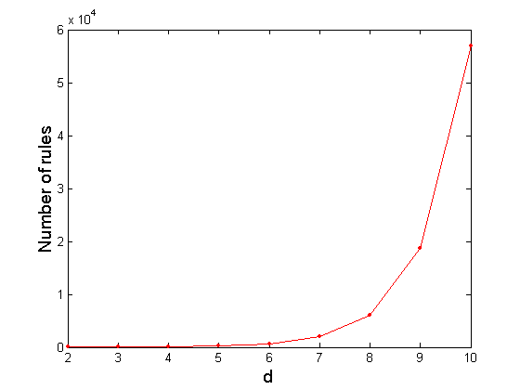
Computational Complexity
Given d unique items in I:
Total number of itemsets = 2^{d}
Total number of possible association rules:
If d=6, R = 602 rules

Slide 52
Mining Association Rules
Example of Rules:
{Milk,Diaper} → {Beer} (s=0.4, c=0.67) {Milk,Beer} → {Diaper} (s=0.4, c=1.0)‏
{Diaper,Beer} → {Milk} (s=0.4, c=0.67)‏
{Beer} → {Milk,Diaper} (s=0.4, c=0.67) {Diaper} → {Milk,Beer} (s=0.4, c=0.5)
{Milk} → {Diaper,Beer} (s=0.4, c=0.5)‏
Observations:
All the above rules are binary partitions of the same itemset: {Milk, Diaper, Beer}
Rules originating from the same itemset have identical support but can have different confidence
Thus, we may decouple the support and confidence requirements
Notes:
52

Slide 53
Mining Association Rules
Two-step approach:
Frequent Itemset Generation
Generate all itemsets whose support ≥ minsup
Rule Generation
Generate high confidence rules from each frequent itemset, where each rule is a binary partition of a frequent itemset
Notes:
53

Slide 54
Rule Generation – Naive algorithm
Given a frequent itemset X, find all non-empty subsets y⊂ X such that y→ X – y satisfies the minimum confidence requirement
If {A,B,C,D} is a frequent itemset, candidate rules:
ABC →D, ABD →C, ACD →B, BCD →A, A →BCD, B →ACD, C →ABD, D →ABC AB →CD, AC → BD, AD → BC, BC →AD, BD →AC, CD →AB,
If |X| = k, then there are 2^{k} – 2 candidate association rules (ignoring L → ∅ and ∅ → L)‏
Notes:
54

Slide 55
Efficient rule generation
How to efficiently generate rules from frequent itemsets?
In general, confidence does not have an anti-monotone property
c(ABC →D) can be larger or smaller than c(AB →D)‏
But confidence of rules generated from the same itemset has an anti-monotone property
Example: X = {A,B,C,D}: c(ABC → D) ≥ c(AB → CD) ≥ c(A → BCD)‏
Why?
Confidence is anti-monotone w.r.t. number of items on the RHS of the rule
Notes:
55

Slide 56
Rule Generation for Apriori Algorithm
Lattice of rules
Low Confidence Rule
Pruned Rules
Notes:
56

Slide 57
Apriori algorithm for rule generation
Candidate rule is generated by merging two rules that share the same prefix in the rule consequent
join(CD→AB,BD—>AC) would produce the candidate rule D →ABC
Prune rule D→ABC if there exists a subset (e.g., AD→BC) that does not have high confidence
CD→AB
BD→AC
D→ABC
Notes:
57

